Slide 1






English Year 2
MODULE 8
THE ROBOT

Slide 2





Welcome,
Students!

Slide 3





LEARNING OBJECTIVES
By the end of the lesson, pupils will be able to :
Give a short sequence of basic instructions.
Understand with support specific information and details of simple sentences.

Slide 4






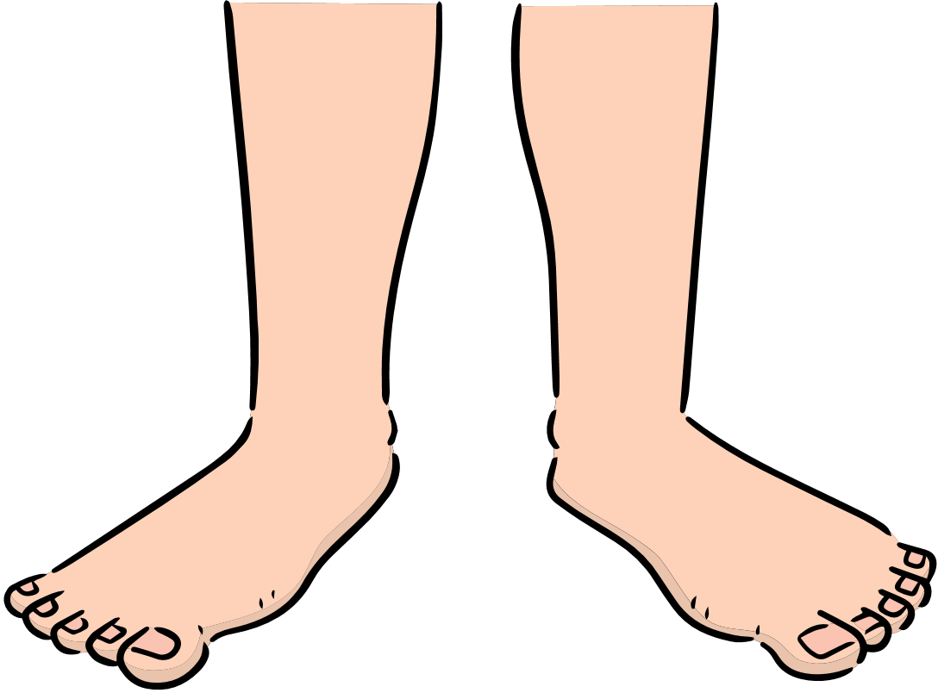
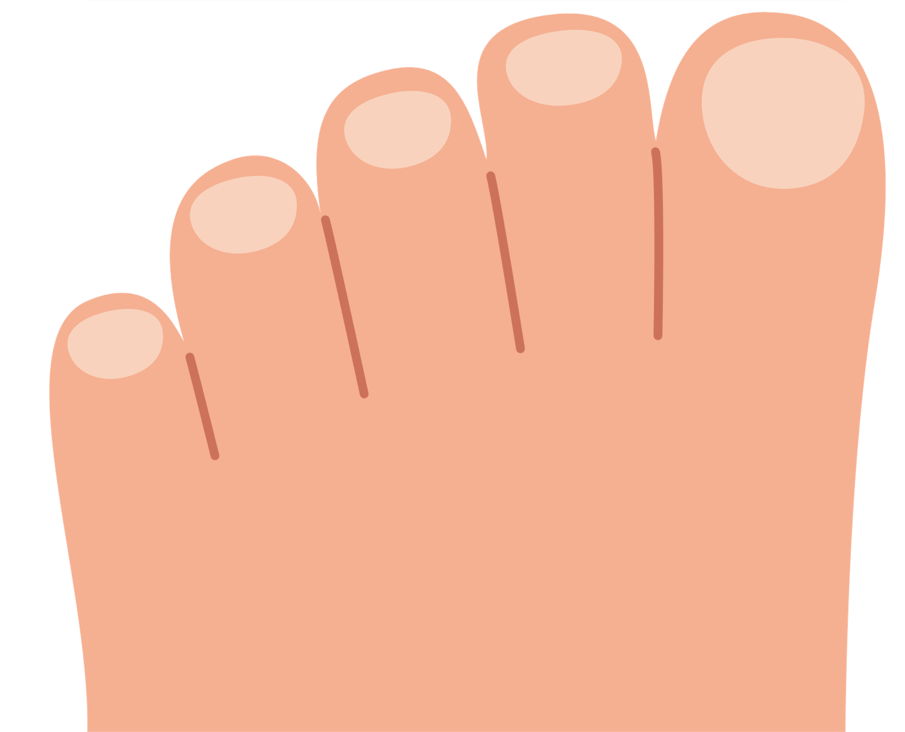
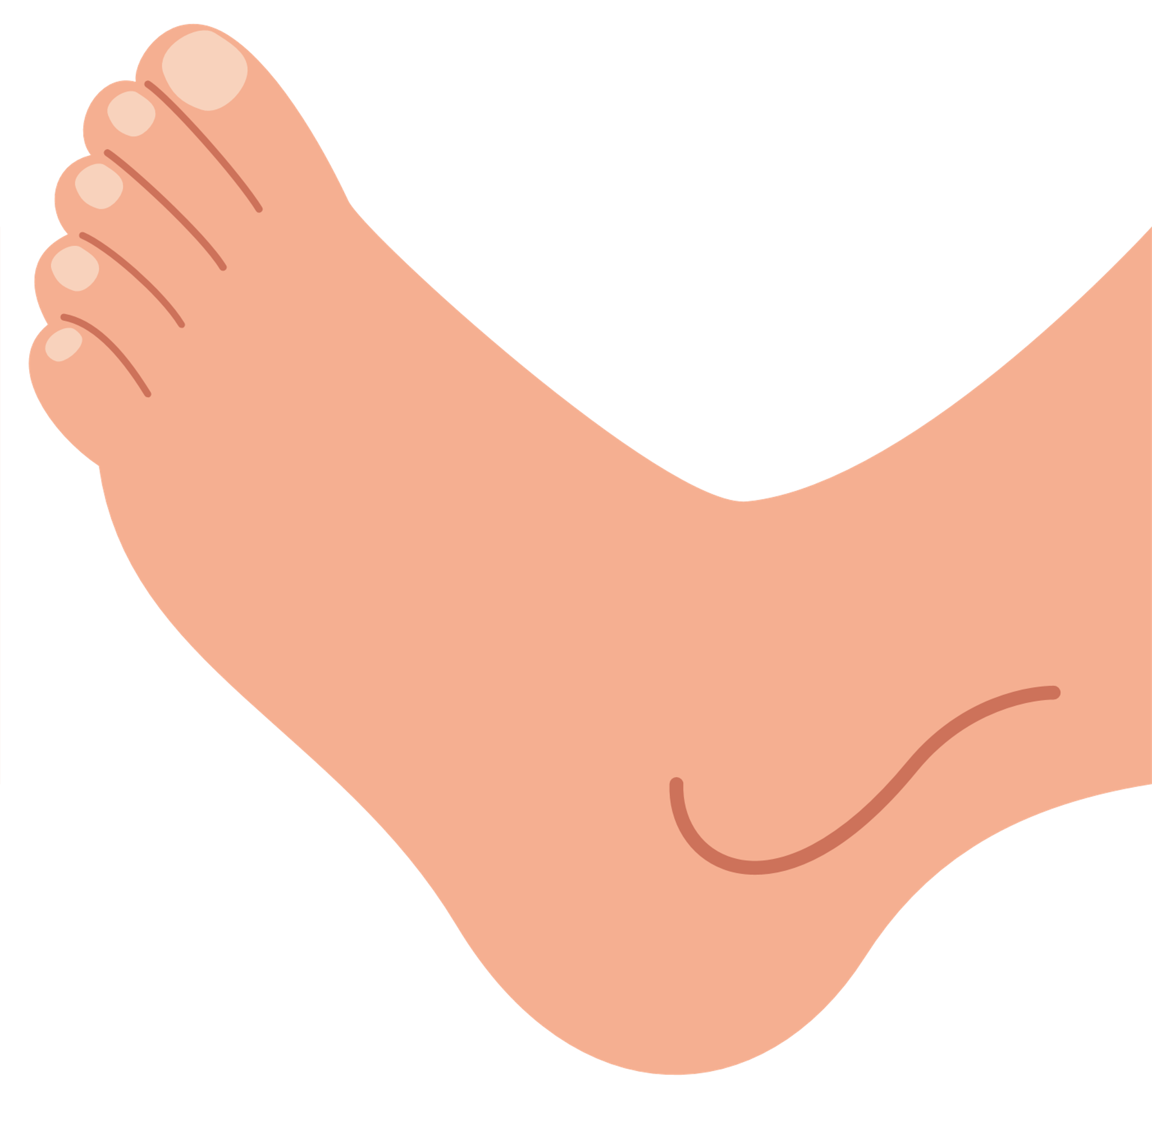
LET'S NAME THE PARTS OF BODY
arm
knee
head
fingers
hand
legs
foot
toes

Slide 5


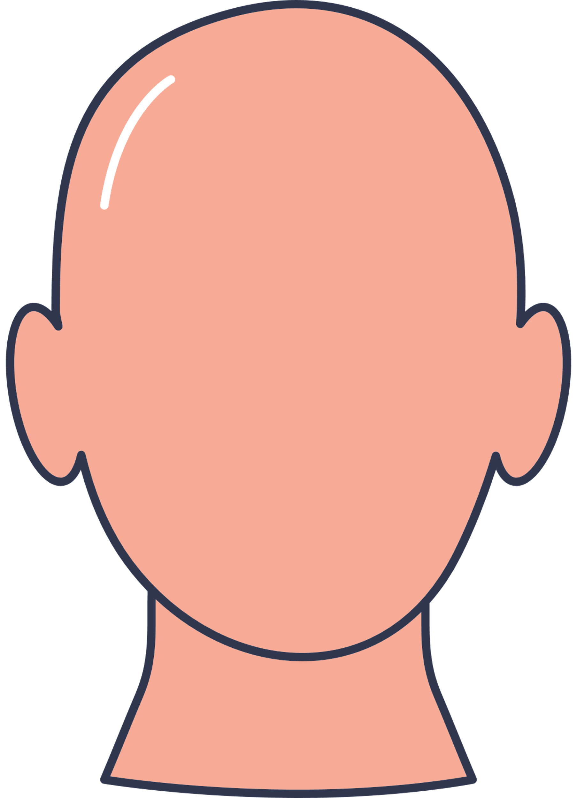
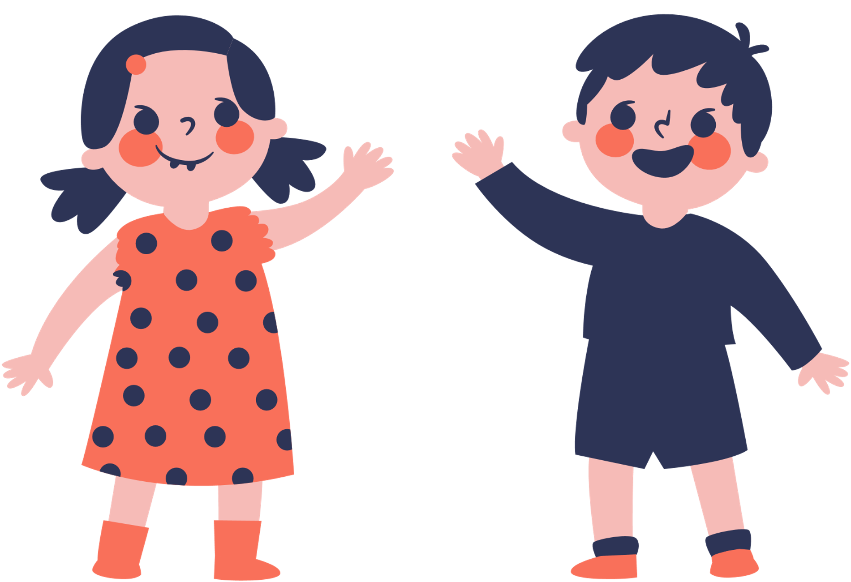
Let's test your knowledge
How many fingers are there?
Which body part is it?

Slide 6

Let's recap on what we have learnt.

Slide 7
Thank you,
Class!

